Slide 1


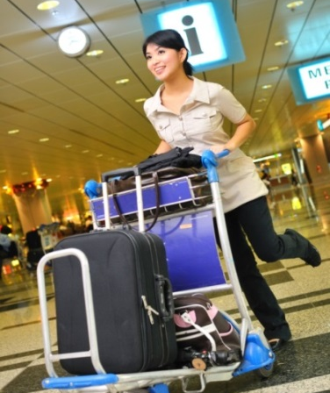



Lead tour groups in a responsible manner
D2.TTG.CL3.11
Notes:
Trainer welcomes students to class.

Slide 2

Subject elements
This unit comprises four Elements:
Identify the pre-requisites for responsible tour leadership
Co-ordinate tour group movements and activities
Facilitate tour group interaction with each other and the tour environment
Deal with on-tour problems
Notes:
Trainer advises this Unit comprises four Elements, as listed on the slide explaining:
• Each Element comprises a number of Performance Criteria which will be identified throughout the class and explained in detail
• Trainees can obtain more detail from their Trainee Manual
• At times the course presents advice and information about various protocols but where their workplace requirements differ to what is presented, the workplace practices and standards, as well as policies and procedures must be observed.

Slide 3

Assessment
Assessment for this unit may include:
Oral questions
Written questions
Work projects
Workplace observation of practical skills
Practical exercises
Formal report from supervisor
Notes:
Trainer advises that assessment for this Unit may take several forms all of which are aimed at verifying they have achieved competency for the Unit as required.
Trainer indicates the methods of assessment that will be applied to them for this Unit.

Slide 4

Element 1:
Identify the pre-requisites for responsible tour leadership
Notes:
Introduce topic.
Class Activity – General Discussion
Ask general questions:
What are the key roles of a tour guide?
What personal characteristics are required to undertake this role?

Slide 5

Identify the pre-requisites for responsible tour leadership
Performance Criteria for this Element are:
Describe host enterprise policies and procedures relating to tour guiding and tour activities
Describe the legal implications involved in conducting guiding activities
Describe the characteristics of effective tour group leaders
Notes:
Trainer identifies the Performance Criteria for this Element, as listed on the slide.

Slide 6

Role of tour guides
Importance of tour guides
A tour guide is responsible for many parts of the tour
They are responsible for ensuring that people in their group have a safe, enjoyable time and that the tour runs as smoothly as possible
Notes:
Class Activity –Discussion & Review of Job description
What are the key functions of tour guides?
Review a job description for a tour guide.

Slide 7

Company policies and procedures
Importance of tour guides
In order to control many tour guide activities, a tourism business will often prepare a series of house rules that staff and management are expected to comply with
These are company policies and standard operating procedures
Notes:
Class Activity –Discussion & Review of SOP’s
What are company policies and standard operating procedures that impact on a tour guide?
Review company policies and standard operating procedures.

Slide 8

Identifying upcoming tours
Identifying upcoming tours
Tours can be ‘special’ tours or ‘scheduled’ tours.
What is the difference?
Notes:
Class Activity –Discussion
Discuss the difference between ‘special’ tours or ‘scheduled’ tours.
Provide examples of how they are different.

Slide 9
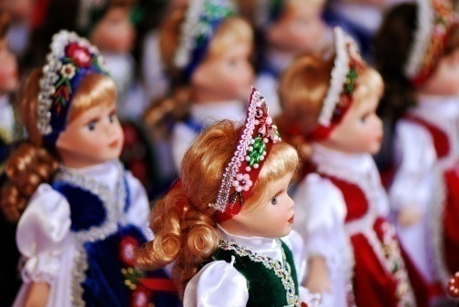
Identifying upcoming tours
Special tours
Tours conducted on a one-off basis for a certain group of people
This tour is customised to meet the needs, wants and preferences of the tour group members
Notes:
Class Activity –Discussion
Identify types of ‘special’ tours
Discuss the inclusions / suggested itinerary of these tours

Slide 10

Identifying upcoming tours
Scheduled tours
Tours conducted on a regular basis every day and are generic in nature
In essence, every tour is the same
Notes:
Class Activity –Discussion
Identify types of ‘scheduled’ tours
Discuss the inclusions / suggested itinerary of these tours

Slide 11

Accessing tour information
Stakeholders to access tour information
Tour guides can become aware of a tour through:
Being advised by site owners, tour group agencies, travel agents or a representative from a club or group
Reading the Advanced Bookings/ Group Bookings file
The regular schedule of tours
Notes:
Class Activity –Discussion & Review Advanced Bookings/Group Bookings file
What stakeholders need information regarding a tour?
What information do each of these stakeholders need?
Review copy of Advanced Bookings/Group Bookings file

Slide 12

Tour brief
The tour brief
A tour brief is a document that allows the manager to define the tasks associated with a tour
The brief informs the guide of all client, product and employer requirements associated with a specific tour
Notes:
Class Activity –Discussion & Review tour briefs
What information is contained in a tour brief?
Review copies of various tour briefs

Slide 13

Tour brief
Information provided in a tour brief
Duration of the tour
Size and structure of the group
Age range, socioeconomic background, cultural background, special interests, and special needs/requirements of the clients
Specific itinerary requirements and tour inclusions
Special clients requirements or requests
Key features of a tour or site
Notes:
Class Activity –Discussion contents of a tour brief
Discuss information included in each of these tour brief points

Slide 14

Tour brief
Information provided in a tour brief
Vouchers for all components - transport, accommodation etc
Airline tickets if relevant
Passenger rooming list
List of industry contacts involved in the tour
Necessary report/ guide forms
Company policy manual guideline
Meal requirements
Notes:
Class Activity –Discussion contents of a tour brief
Discuss information included in each of these tour brief points

Slide 15

Contracts
Contracts
An essential aspect of confirming details of any forthcoming tour is to read any accompanying documentation.
One of these vital documents is any tour contracts:
What information is contained in a contract?
Notes:
Class Activity –Review & discuss contents of a contract
Review tour contracts.
Discuss information included in contracts.

Slide 16

Tour Itinerary
Tour Itinerary
The tour itinerary is the road map for any tour
An itinerary is a list, or description of travel arrangements
Notes:
Class Activity –Discussion & Review tour itineraries
What information is contained in a tour itinerary?
How does it differ to a tour brief?
Review copies of various tour itineraries

Slide 17

Tour Itinerary
Tour Itinerary
Domestic and international flights
Transfers
Rail and coach journeys, care hire and ferry journeys
Accommodation of various types
Any packaged tours
Entry to attractions or events
Meals and sightseeing
Notes:
Class Activity –Discussion contents of a tour itinerary
Discuss information included in each of these tour itinerary points

Slide 18

Role of group leader
Identifying the group leader
Exactly who is the group leader can vary between the tour groups:
Why is it important to identify the group leader?
What needs to be discussed with this person?
Notes:
Class Activity –Discussion
Discuss the questions in the slide.

Slide 19

Confirming tour details
Confirming details of the tour
The details of a tour should be confirmed wherever possible in advance:
Who should be contacted?
What needs to be confirmed?
How can you get this confirmation?
Notes:
Class Activity –Discussion
Discuss the questions in the slide.

Slide 20

Confirming tour details
Details to be confirmed
Details to be confirmed may include:
Group profile
Transport arrangements
Itinerary
Notes:
Class Activity –Discussion
Discuss information to be confirmed for each of these points.
When do details need to be confirmed by?
Who needs this information?

Slide 21

Confirming tour details
Making changes to the arrangements
Management and our guides should always try to accommodate changes to agreed arrangements required by the client:
Record all changes required
Notify others as necessary
Advise client/group of additional charges
Notes:
Class Activity –Discussion about making changes to arrangements
What are policies about changes being made to tour arrangements
Where are changes recorded?
How do you know which is the current version of tour arrangements?
What are examples of changes that can be made and costs associated with making these changes?

Slide 22

Being organised and well prepared
Ensure you are ready to deliver tours
It is important for all staff in any job to be well organised
It is vital that you are prepared and ready to deliver tours
Notes:
Class Activity –Identify pre-tour planning activities
Prepare a list of all activities to be performed before a tour takes place.

Slide 23

Being organised and well prepared
It is essential tour guides can:
Identify the upcoming tours they need to conduct.
Determine the things they need to plan and create for each of the upcoming tours
Project an image of professionalism, control and confidence
Provide a positive visitor experience
Optimise safety for the people on the tour
Notes:
Class Activity – Discuss pre-tour planning activities
Discuss the activities associated with each of these points.

Slide 24

Ensure planning is complete
Ensure tour guides planning
As part of the planning process tour guides must:
Dress properly
Have prepared and practised the commentary
Be at the appointed starting point for the tour well in advance
Notes:
Class Activity –Discuss pre-tour planning activities
What is considered to be ‘proper’ or ‘appropriate’ attire for a tour guide.

Slide 25

Ensure planning is complete
Ensure tour guides planning
Have organised all support materials necessary for the tour
Verify the muster point is ready
Contact group leader and confirmed all details
Confirm the arrangements for the tour have been prepared
Notes:
Class Activity – Discuss pre-tour planning activities
Discuss the activities associated with each of these points.

Slide 26

Prepare commentary
Preparing a commentary
As part of a tour guides’ role will usually be to deliver a pre-prepared commentary
This may be prepared by management or the tour guides themselves
Where no script exists tour guides may be required to prepare one
Notes:
Class Activity – Discuss purpose of a commentary
What is commentary?
What is the purpose of having commentary?
What parts of a tour require commentary?

Slide 27

Prepare commentary
Preparing a commentary
Preparing a commentary is not a simple or easy exercise, and the following points should be understood:
Writing a commentary takes time
Understand all attraction information
Check tour advertisements
Know the route
Involve others
Experience other commentaries
Notes:
Class Activity – Discuss purpose of a commentary
Discuss the importance of these points

Slide 28

Prepare commentary
Key points of commentaries
Avoid personal opinions, thoughts, beliefs and prejudices
Avoid inappropriate language - tour guides should prepare a draft
Tour guides must ‘speak’ the commentary when trialling it
Tour guides have to read it out loud to others for their feedback
Use simple, plain language
Notes:
Class Activity – Prepare, print and deliver a commentary (Refers to slides 28-30)
Participants are to prepare a commentary for an aspect of a tour.
They are then to deliver their commentary to the audience.

Slide 29

Prepare commentary
Produce hard copy of commentary
The best way to record commentary is by using cue cards
Cue cards are small cards which fit into the palm of tour guides’ hand
Tour guides can write headings and dot points on these cards to outline the main ideas of their commentary
Notes:
Class Activity – Prepare, print and deliver a commentary (Refers to slides 28-30)
Participants are to prepare a commentary for an aspect of a tour.
They are then to deliver their commentary to the audience.

Slide 30

Prepare commentary
Practicing the commentary
Tour guides must practice any commentary they have to present:
Reading it out aloud several times
Reading it in situ
Bringing the standard commentary to life with personal anecdotes or knowledge as appropriate to the venue, topics or interests of the group
Notes:
Class Activity – Prepare, print and deliver a commentary (Refers to slides 28-30)
Participants are to prepare a commentary for an aspect of a tour.
They are then to deliver their commentary to the audience.

Slide 31

Grooming and attire
Outlining personal grooming and attire guidelines
Uniform and name badges
Personal appearance and hygiene
Personal well being
Notes:
Class Activity – Discuss importance of personal grooming and attire
Discuss the importance of these points
What aspects of personal appearance and hygiene must be considered?
How can you maintain personal well being

Slide 32

Organise information and materials
Steps in organising information and materials
Sufficient items are obtained
Information is current an accurate
Available in different languages to suit the known language of the tour group
Addresses the identified objectives or themes for the group
Notes:
Class Activity – Discuss information and materials to be organised
What information needs to be arranged? Prepare a list.
What materials need to be arranged? Prepare a list.
What activities are associated with arranging information and materials?

Slide 33

Organise information and materials
Types of information and materials
Log book
Inspection checklists
Support materials or props
Merchandise/give-aways
Tickets and vouchers
Name tags
Notes:
Class Activity – Discuss information and materials to be organised
Discuss the importance of each of these points.
What is there purpose?
What needs to be arranged?

Slide 34

Organise information and materials
Types of information and materials
Communication equipment
Personal protective equipment and clothing
Equipment
Brochures and site maps
Handouts
A ‘We are here’ flag
Notes:
Class Activity – Discuss information and materials to be organised
Discuss the importance of each of these points.
What is there purpose?
What needs to be arranged?

Slide 35

Security policies and procedures
Understand security policies and procedures
Tour guides must:
Identify what the security policies and procedures are
Ensure they understand the security policies and procedures
Ensure they follow them
Notes:
Class Activity – Discuss importance and review security policies and procedures
Why is it important to have security policies and procedures?
Review various security policies and procedures.

Slide 36

Security policies and procedures
Types of security policies and procedures
Security procedures for tours may have been developed and written focused on:
Customers
Staff
Property
Documentation
Notes:
Class Activity – Discuss security policies and procedures
What are examples of security policies and procedures for each of these audiences?

Slide 37
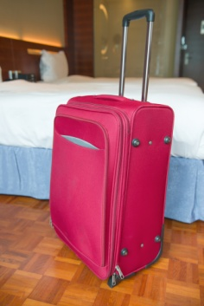
Security policies and procedures
Types of security policies and procedures
Cash and non-cash transactions
Equipment
Theft
Emergency procedures and evacuations
Other events likely to endanger customers or staff
Notes:
Class Activity – Discuss & review security policies and procedures
Review examples of security policies and procedures for each of these points?

Slide 38
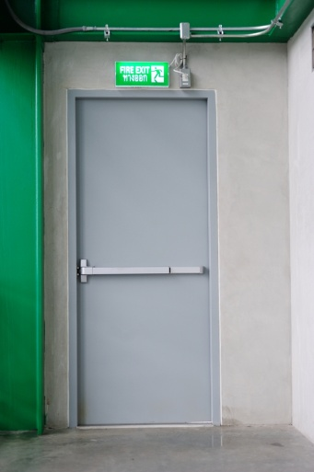
Security policies and procedures
Types of assets
Whilst the types of assets will vary depending on the demands of specific tours, common assets that need to be controlled and managed include:
Keys
Security Passes
Equipment
Notes:
Class Activity – Discuss role and examples of assets
What are examples of assets for each of these points?
What is their purpose?

Slide 39

Types of assets
Keys
Keys may be needed for:
Doors
Vehicles
Displays
Padlocks
Gates
Enclosures
Emergency exits
Notes:
Class Activity – Discuss role and examples of keys
What is their purpose?
How are keys kept secure?

Slide 40
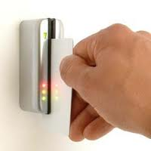
Types of assets
Security passes
Security pass in some venues there can be a need for the person delivering the tour to apply for, and obtain, a security pass before being granted access to nominated areas
Notes:
Class Activity – Discuss role and examples of security passes
What is their purpose?
How are security passes kept secure?

Slide 41

Types of assets
Equipment
Communication systems and items
Personal audio facilities
Audio-visual equipment
Computers
Activity items
Notes:
Class Activity – Discuss role and examples of equipment
What is their purpose?
What are examples of each type of equipment?
How are these pieces of equipment kept secure?

Slide 42

Types of assets
Security of assets
There will always be a number of policies and procedures in relation to assets including:
Restricting access
Signing for assets
Using safes and locked storage areas
Policy forbidding the lending of assets
They are compliant with regulations
Notes:
Class Activity – Discuss importance of securing assets
Discuss how these security measures can be implemented.
What other methods can be used?

Slide 43
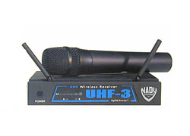
Check public address system
Aspects of public address system
In-house systems
Portable system
Megaphones
Notes:
Class Activity – Discuss & demonstrate purpose and aspects of public address system
Trainer to demonstrate each aspect of public address system

Slide 44
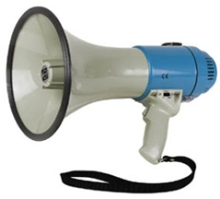
Check public address system
Check understanding and readiness of public address system
It is essential that guides understand:
The different components of the public address system
Ensure the system is ready for use
How to use and control the system
Notes:
Class Activity – Discuss & demonstrate how to check understanding and readiness of public address system
Trainer to demonstrate how to check understanding and readiness of public address system

Slide 45
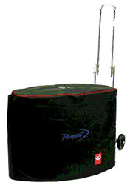
Test equipment
Ensure equipment has been tested
Three basic requirements about testing equipment before a tour are:
Never ‘forget’ to do these checks
Take time doing the tests and inspections
Check, test and verify all the items, systems or equipment
Notes:
Class Activity – Discuss & demonstrate how to ensure equipment has been tested
Trainer to demonstrate how to ensure equipment has been tested

Slide 46

Check materials
Types of materials
Props, materials and aids might include:
Work sheets
Pens and pencils
Binoculars
Maps
Photos
Posters
Notes:
Class Activity – Discuss types of materials
Discuss the importance and examples of each type of material.
How can you check to ensure each of these are ready for a tour?

Slide 47

Check materials
Types of materials
Torches (for night tours)
Observation or activity sheets
Plant samples
Feathers, horns, antlers
Blindfolds
Notes:
Class Activity – Discuss types of materials
Discuss the importance and examples of each type of material.
How can you check to ensure each of these are ready for a tour?

Slide 48
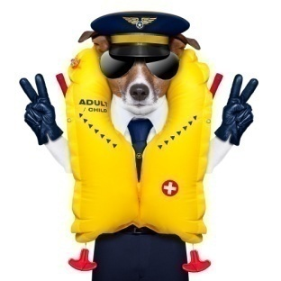
Check materials
Types of materials
Diagrams
Information leaflets
Costumes
Electronic guides
Beverages / foods / holders
Notes:
Class Activity – Discuss types of materials
Discuss the importance and examples of each type of material.
How can you check to ensure each of these are ready for a tour?

Slide 49

Legal implications
Understand legal implications
Like in any business activity, a tour guide will need to follow and adhere to laws and regulations
Notes:
Class Activity – List legal implications that impact on a tour
Audience to prepare a list of any legal implications that impact on a tour.

Slide 50

Legal implications
Corporate governance
Corporate governance is the system by which companies are directed and managed
It influences how the objectives of the company are set and achieved, how risk is monitored and assessed, and how performance is optimised
Notes:
Class Activity – Discuss importance of corporate governance
Why is corporate governance important?
How can you ensure good corporate governance?

Slide 51

Legal implications
Corporate governance
Why is their a need for good corporate governance?
What are corporate governance responsibilities?
What are areas of corporate governance?
Notes:
Class Activity – Discuss importance of corporate governance
Discuss questions in the slide.

Slide 52

Legal implications
Health and Safety
All businesses are subject to Occupational Health and Safety (OHS) legislation
One of the tourist guides main concerns is the health and safety of their customers
Notes:
Class Activity – Discuss importance of Health and Safety
Why is health and safety important?
How can you ensure sufficient health and safety for a tour?
Review Occupational Health and Safety (OHS) legislation

Slide 53

Legal implications
Principles of health and safety protection
To secure the health, safety and welfare of everyone
To eliminate, at the source, risks to the health, safety or welfare of everyone
To ensure that the health and safety of members of the public is not placed at risk
To provide for the involvement of all in developing health and safety standards
Notes:
Class Activity – Discuss importance of Health and Safety
What are types of health and safety legislation

Slide 54
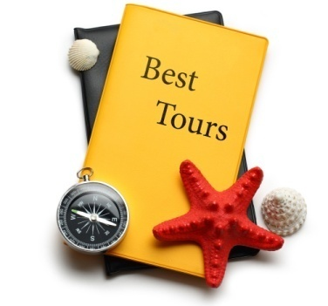
Legal implications
Duty of care
Legislation notwithstanding, tour companies and tour guides themselves owe a common law ‘duty of care’ to their customers
Common law is law which is not the result of legislation
Notes:
Class Activity – Discuss importance of Duty of care
Why is duty of care important?

Slide 55

Legal implications
Duty of care
Duty of care provisions require a business to take reasonable care to ensure that ‘foreseeable harm’ does not occur to people
Notes:
Class Activity – Discuss importance of Duty of care
What are examples of duty of care?

Slide 56

Legal implications
Employee Code of Conduct
Employees who work in the front line of an organisation dealing with the customers directly, as a tourist guide, will often be required to adhere to a code of conduct
Notes:
Class Activity – Discuss importance and review Employee Code of Conduct
Why it is important to have an Employee Code of Conduct?
What information is contained within an Employee Code of Conduct?
Review an example of this document.

Slide 57

Legal implications
Employee Code of Conduct
This might include:
Expectations on personal presentation
Restrictions on the content of commentary
Expectations about absenteeism or tardiness
How to treat company property
Conflicts of interest
Personal behaviour i.e. Fighting or arguing
Responsibilities regarding health and safety
Notes:
Class Activity – Discuss importance and review Employee Code of Conduct
Identify examples of each point.

Slide 58

Legal implications
Fair trading legislation
Fair trading legislation places obligations on businesses to:
Avoid misleading and deceptive contact
Not to use unfair consumer contracts
Avoid unconscionable conduct
Issue receipts and itemised bills
Notes:
Class Activity – Discuss importance of Fair trading legislation
Why is this important?
What are examples of fair trading?

Slide 59

Legal implications
Ethical requirements
Ethical requirements relate to issues about which a personal judgement has to be made regarding the way either the tourism organisation or tour guides themselves elect to conduct its business
Notes:
Class Activity – Discuss importance of Ethical requirements
What are ethics?
Why is this important?
What are examples of ‘ethical behaviour’?

Slide 60
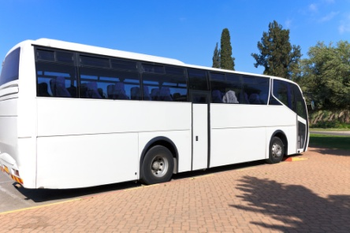
Legal implications
What aspects of business have an ethical component?
Products
Service provision
The environment
People
The community
Tipping
Notes:
Class Activity – Discuss importance of Ethical requirements
What are examples of ‘ethical behaviour’ in each of these categories?

Slide 61

Legal implications
What aspects of business have an ethical component?
Discrimination against certain types of customers
Money benefiting personal use
Promotions and advertising
Intellectual property
Conflict of interests
Notes:
Class Activity – Discuss importance of Ethical requirements
Discuss these points.
What are examples of ‘non-ethical’ behaviour for each point.

Slide 62

Legal implications
Risk assessment & management
Formal and structured risk assessment coupled with proactive and comprehensive risk management activities are becoming increasingly common in business:
What is the difference between risk assessment and risk management?
Notes:
Class Activity – Discuss importance of Risk assessment & management
Why is Risk assessment & management important?
Discuss the question in the slide.

Slide 63

Legal implications
Risk assessment
Risk assessment involves:
Identifying the risks
Analysing the identified risk
Evaluating the severity of the identified risk
Notes:
Class Activity - Risk assessment Activity
Participants are to conduct a risk assessment for a tour of their choice.

Slide 64

Legal implications
Risk management
Risk avoidance strategies
Risk reduction strategies
Risk retention strategies
Risk transfer strategies
Notes:
Class Activity - Risk management Activity
Based on the risk assessment activity in the previous slide, participants are to identify a risk management plan for risks identified.

Slide 65

Role of the tour guide
Different roles of a tour guide
Mediator
Communicator
Manager
Teacher
OHS representative
Sales person
Notes:
Class Activity – Discuss roles of a tour guide
Provide examples of activities or situations for each of these points.

Slide 66

Role of the tour guide
Characteristics of effective tour group leaders
Ability to be proactive
Being an effective communicator
Respect for others
Confidence
Enthusiasm
Notes:
Class Activity – Discuss characteristics of a tour guide
Provide examples of situations for each of these points.

Slide 67

Role of the tour guide
Characteristics of effective tour group leaders
Fairness and consistency
Open-mindedness
Knowledgeable, skilful and competent
Organisational ability
Initiative
Ability to direct and delegate
Notes:
Class Activity – Discuss characteristics of a tour guide
Provide examples of situations for each of these points.

Slide 68

Element 2:
Co-ordinate tour group movements and activities
Notes:
Introduce topic.
Class Activity – General Discussion
Ask general questions:
What are different activities that are undertaken as part of a tour?
What are key activities performed by a tour guide whilst a tour is being conducted?

Slide 69

Co-ordinate tour group movements and activities
Performance Criteria for this Element are:
Advise tour group members of the type of tour and the proposed movements and activities and
Maintain adherence to the tour itinerary to the greatest extent possible
Provide tour-related advice and information to the tour group members
Supervise movement and activities of the tour group
Notes:
Trainer identifies the Performance Criteria for this Element, as listed on the slide.

Slide 70

Co-ordinate tour group movements and activities
Performance Criteria for this Element are:
Encourage tour group members to participate in the tour
Modify planned activities, add new activities and/or delete activities where required to meet identified special needs of tour group members
Optimise compliance with host enterprise policies and procedures, and host country legal requirements while on tour
Notes:
Trainer identifies the Performance Criteria for this Element, as listed on the slide.

Slide 71

Co-ordinate tour group movements
Conduct a tour
This section will focus on the activities associated with conducting and leading the actual tour
As can be expected, there are many activities to be performed by tour guides
Notes:
Class Activity – Discussion
What are key activities performed by a tour guide whilst a tour is being conducted?

Slide 72

Types of tours
Types of tour group members
Domestic and international people
Males and females
People from different age groups
Special interest groups
Special needs customers
Open groups
Homogenous target market groups
Notes:
Class Activity – Discussion about types of tour group members
What are the needs of each type of group member that tour guides must take into consideration?
How can they meet these needs?

Slide 73

Types of tours
Focus of tours
History
Flora and fauna
Natural attractions
Action experiences
Shopping
General interest
Notes:
Class Activity – Discussion about focus of tours
What activities / attractions would you include for each of these tours?
What are other possible focuses of tours?

Slide 74
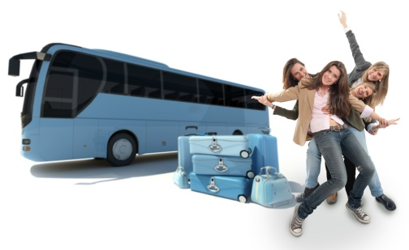
Types of tours
Types of tours
Half and full day tours
Extended tours
City, rural and remote area tours
Cultural and eco-tours
Adventure and recreational tours
Special interest tours
Walking tours
Four-wheel drive tours
Boating, aerial and cruise tours
Notes:
Class Activity – Review / internet research into types of tours
Review brochures or conduct internet research in relation to each of these tours to provide examples

Slide 75

Greeting participants
Getting ready to greet participants
To give tour participants a positive and welcoming greeting tour guides must:
Be prepared
Be there
Notes:
Class Activity – Discussion
What needs to be prepared to greet participants?

Slide 76

Greeting participants
Greeting of participants
Before embarking on a tour, it is important that you meet and greet your customers:
How should you greet someone?
What should you say?
What other activities should be done?
What checks should be made?
Notes:
Class Activity – Discussion
Discuss questions in the slide.

Slide 77

Give introduction
Giving introduction of site and tour
Tour guides’ introduction should:
Introduce tour guides themselves to the group
Name the group as part of the talk
Identify the site or tour area
Explain the type of tour
Provide an overview of what the tour will cover
Introduce any personnel who will be part of the tour
Include a Q & A session
Notes:
Class Activity – Discussion & Role Play
Discuss information to be explained for each of these points
Role Play in greeting and introducing a tour

Slide 78

Explain tour
Explain the tour itinerary
Explaining the itinerary
Explain the type of tour they are taking
Provide an overview of what the tour will cover
Procedures at tour stops and time spent at each stop
Notes:
Class Activity – Discussion & Role Play
Discuss information to be explained for each of these points
Role Play in explaining the tour itinerary

Slide 79
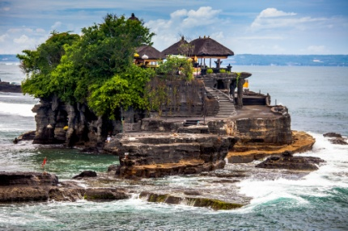
Explain tour rules
Explain rules, procedures and regulations
Health and safety procedures
Local regulations
Group rules and regulations
Specific site procedures
Cultural considerations
Environmental considerations
Notes:
Class Activity – Identify rules, procedures and regulations
What is the different between rules, procedures and regulations.
For each of the points in this slide, provide examples of possible rules, procedures and regulations.

Slide 80

Maintain adherence to itinerary
Maintain adherence to the tour itinerary
As the tour guide you must follow the itinerary exactly. You must be aware of everything that is listed on the tour itinerary:
When a customer receives their tour itinerary they are expecting and looking forward to seeing the sites listed on the itinerary
It is your responsibility to ensure that you fulfil those expectations
Notes:
Class Activity – Maintain adherence
Why is it important to maintain adherence to the tour itinerary ?
How can this be done?

Slide 81

Maintain adherence to itinerary
Maintain adherence to the tour itinerary
Monitoring times to maximise the chance of staying on schedule
Adjusting destinations and activities on the basis of events arising and time blow-outs
Modifying allocated timelines on the basis of events arising and time blow-outs
Notes:
Class Activity – Maintain adherence
Discuss the points in the slide, providing examples

Slide 82

Maintain adherence to itinerary
Maintain adherence to the tour itinerary
Liaising with staff, tour group members and providers to vary the itinerary, as necessary
Applying effective communication and negotiation skills to provide the basis for regaining the scheduled itinerary
Notes:
Class Activity – Maintain adherence
Discuss the points in the slide, providing examples

Slide 83

Maintain adherence to itinerary
Changing the itinerary
What are causes?
What should you do when changing the itinerary?
Why is it important to have a contingency plan?
Notes:
Class Activity – Discussion about changing the itinerary
Discuss the questions in the slide.

Slide 84

Provide tour advice and information
Provide tour-related advice and information to the tour group members
Given that customers may considerable money to be part of a tour, they expert to experience venues, receiving the greatest possible benefit from the experience
Notes:
Class Activity – Discussion about providing tour-related advice
What do tour members expect in terms of information?

Slide 85
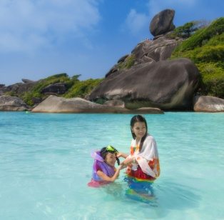
Provide tour advice and information
Tour member expectations
Having a smooth visit
Visiting all necessary sights
Not getting lost or delayed
Receiving accurate and informative information
Being given helpful information or materials to help enhance the experience
Notes:
Class Activity – Discussion about providing tour-related advice
Discuss these expectations.
How can you ‘exceed’ these expectations?

Slide 86

Provide tour advice and information
Familiarise self with locations
Why is this important?
What do you need to know?
How can you find this information?
Notes:
Class Activity – Discussion about providing tour-related advice
Discuss the questions in the slide.

Slide 87

Provide tour advice and information
Importance of non-verbal and verbal communication skills
What is this importance of:
Non-verbal skills
Verbal communication skills
Interpersonal skills
Need for alignment between verbal and non-verbal language
Notes:
Class Activity – Discussion importance of communication skills
Why are communication skills important?
Discuss the different types of communication skills in this slide.

Slide 88
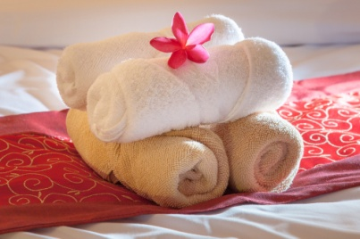
Provide tour advice and information
Using basic communication to deliver commentary
Basic communication strategies
Communication techniques
Deliver your commentary
Provide tour-related advice and information
Provide information on local attractions and activities
Consider audience learning styles
Adjusting commentary to unexpected
Notes:
Class Activity – Discussion about importance of communication skills
Discuss strategies on how you can maximise your communication skills to meet the points in this slide.

Slide 89

Supervise movement and activities
Supervise movement and activities
Providing advance warning and information of up-coming activities and destinations
Directing tour group members to locations
Leading tour group members to activities and locations
Taking action to minimise unscheduled tour group member activities that jeopardise the itinerary
Notes:
Class Activity – Discussion about importance of supervising movement and activities
Why is it important to supervising movement and activities?
What do you need to supervise?
How can you do this?
Review documents / tools used to supervise and manage movement

Slide 90

Monitoring people
Counting participants
To assist keeping track of tour group members it is advisable to ensure tour guides use consistent procedures to count participants throughout the tour:
When should this be done?
How should it be done?
Notes:
Class Activity – Discussion about importance of counting participants
Discuss questions in the slide.

Slide 91

Monitoring people
Locate lost or late tour group members
A lost member is one who does not know how to locate you or does not know where they are:
How should you handle this situation?
How do you handle ‘lost children’?
Notes:
Class Activity – Discussion about importance of locating lost persons
Discuss questions in the slide.

Slide 92

Monitoring people
Managing tour group in crowds
The need to consider crowds is necessary to:
Determine if the presence of crowds will interfere with the conduct of a tour
Determine if the crowd poses a threat to the tour and its members
Responding to crowds
Notes:
Class Activity – Discussion about managing tour group in crowds
How can you manage tour group in crowds?

Slide 93

Encourage tour group members
Encourage tour group members to participate
All tours must be delivered for the benefit of the tour group members.
Naturally the more tour members feel they are 'part' of the tour and seen as a valuable inclusion, the greater their satisfaction will generally be:
How can you do this?
Notes:
Class Activity – Discussion about encouraging tour group members
Discuss question in the slide.

Slide 94

Encourage tour group members
Ways to involve participants
Providing incentives
Issuing challenges
Asking questions
Listening to comments and feedback
Allowing participants to contribute expertise or knowledge
Acknowledging attempts and achievements
Providing hands-on or participatory activities
Notes:
Class Activity – Discussion about encouraging tour group members
Provide examples / strategies for each point in this slide.

Slide 95

Meeting special needs
Modifying activities to meet special needs
Whilst most tour activities should be conducted as scheduled, there will be times where activities need to be modified to meet an special needs of individual tour members:
What are types of special needs?
How can you identify these needs?
What can you do to accommodate these needs?
Notes:
Class Activity – Discussion about modifying activities
Discuss question in the slide.

Slide 96

Comply with policies, procedures and standards
The objective of this task is to understand operating procedures, processes, policies and service delivery standards of the host organisation:
What is a policy?
What is a procedure?
What is a standard?
What are examples of each?
Notes:
Class Activity – Discussion
Discuss question in the slide.

Slide 97

Comply with policies, procedures and standards
Standard Operating Manual
Consists of all policies, procedures and standards required by the organisation to run efficiently and professionally:
What topics are contained within a SOM?
Notes:
Class Activity – Discussion & Review of Standard Operating Manual
Discuss question in the slide
Review of Standard Operating Manual

Slide 98
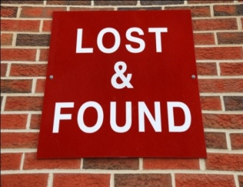
Comply with policies, procedures and standards
Specific tour related policies and procedures
Lost or found items
Troublesome Guests
Guest complaints
Notes:
Class Activity – Identify specific tour related policies and procedures
Identify specific tour related policies and procedures for each of the points in this slide.
Are there other specific tour related policies and procedures for other aspects of a tour?

Slide 99

Element 3:
Facilitate tour group interaction with each other and the tour environment
Notes:
Introduce topic.
Class Activity – General Discussion
Ask general questions:
Why is it important for tour group members to interact with each other?

Slide 100

Facilitate tour group interaction with each other and the tour environment
Performance Criteria for this Element are:
Introduce tour group members to each other, where appropriate
Explain the objectives and opportunities provided by participating in the tour
Use techniques to build and maintain group cohesion on tour
Share and explain general rules that apply to group members while on tour
Balance the needs of the group with individual needs
Notes:
Trainer identifies the Performance Criteria for this Element, as listed on the slide.

Slide 101

Introduce tour members
Introduce tour group members to each other
The use of name tags
An "icebreaker" activity
Notes:
Class Activity – Conduct an "icebreaker" activity
Audience is to prepare and conduct an "icebreaker" activity

Slide 102

Explain tour objectives
Explain tour objectives & opportunities
Education
Experience
Relaxation, fun
Excitement
Celebration of an event or an historical date
Money raising
Recreation
Notes:
Class Activity – Identify tour inclusions based on objectives
For each of these objectives, what are possible tour inclusions that can be considered?

Slide 103
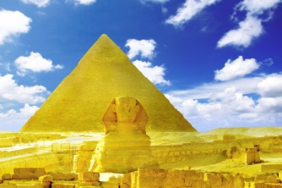
Explain tour themes
Understanding tour themes
Language
Music
The environment
Culture
Arts
Animals
Food
Notes:
Class Activity – Identify tour inclusions based on themes
For each of these themes, what are possible tour inclusions that can be considered?

Slide 104
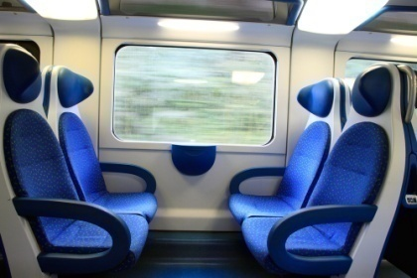
Build group cohesion
Techniques to build and maintain group cohesion
Utilising initial introduction techniques
Encouraging interaction between group members
Initiating group activities or games
Inviting individuals to address the group
Utilising the skills of individual tour group members within the tour
Focusing the group on shared experiences
Using seat rotations systems
Notes:
Class Activity – Discussion to build and maintain group cohesion
Why is it important to build and maintain group cohesion?
What are other strategies you can use?

Slide 105

Build group cohesion
Techniques to build and maintain group cohesion
Creating opportunities for individual interaction
Accommodating individual preferences, where possible
Keeping group informed about the itinerary and planned changes
Facilitating attempts at group cohesion
Creating and supporting attempts to optimise goodwill and group morale
Notes:
Class Activity – Discussion to build and maintain group cohesion
Why is it important to build and maintain group cohesion?
What are other strategies you can use?

Slide 106

Build rapport
Rapport-building techniques
Extending and building on the conversations had when you greeted people
Asking participants questions
Using icebreakers
Using anecdotes
Using humour
Checking on people’s welfare
Applying suitable interpersonal and communication skills
Considering cultural characteristics
Notes:
Class Activity – Discussion to build rapport
What is rapport?
Why is it important to rapport?
Identify examples for each point.
What are other strategies you can use?

Slide 107

Share tour rules
Types of general rules
Acceptable and unacceptable behaviour
Respect for others and the environment
Need for sharing
Need to observe time constraints
Basic requirements to ensure safety and security of tour group members and their possessions
Action to take in the event of an accident or emergency
The need to communicate and provide feedback to tour leader
Notes:
Class Activity – Discussion about rules.
Why are these rules important?
What are examples for each of these points?
What other rules would you implement if you were a tour guide?

Slide 108

Making announcements
Making announcements
Location of facilities
Do’s and don’t’s of the tour
Advice on what to do if a person becomes separated from the group
Encouragement to group to enjoy, participate and engage
Laundry options
Relaxation options
Notes:
Class Activity – Discussion about making announcements
What are pieces of information that would be included in each of these points?

Slide 109
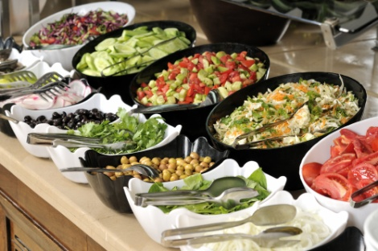
Monitor tour delivery
Making announcements
Eating venues
Meal arrangements
Meal times
Tipping
Dietary requirements
Cuisines
Notes:
Class Activity – Discussion about making announcements
What are pieces of information that would be included in each of these points?

Slide 110

Monitor tour delivery
Making announcements
Safety precautions
Advising tour group members about safety precautions
Theft procedures
Site policies
Notes:
Class Activity – Discussion about making announcements
What are pieces of information that would be included in each of these points?

Slide 111

Balance group and individual needs
Recognising special needs of group
What are types of special needs?
How can you identify them?
What is the standard protocol when dealing with special needs?
Notes:
Class Activity – Discussion about recognising special needs of group
Discuss the questions in this slide.

Slide 112
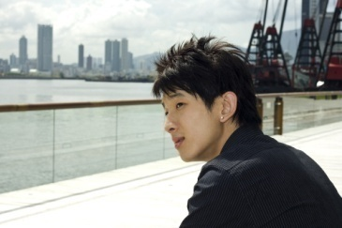
Assessing tour group needs
Methods of monitoring needs
Visual observation
Listening to comments made
Being informed directly by someone
Asking regular questions of the group or individuals within the group
Creating an environment which encourages them to inform tour guides if they have any issues, concerns or personal requests
Notes:
Class Activity – Discussion about importance of monitoring needs
Why is it important to monitoring needs?
What activities are associated with each of these points?
What other monitoring methods can be used?

Slide 113

Consider needs and wishes of participants
Types of considerations
Quiet time
Free time
A time for people to chat
Personal enjoyment of site
Tour group members to have a rest
Photo opportunities
‘Up close and personal’ opportunities
Preferential treatment
Notes:
Class Activity – Meeting customer considerations
Provide examples of how you can accommodate these considerations.

Slide 114

Balance group and individual needs
Balancing the needs of the group with individual needs
Introducing supplementary activities to cater for identified need
Ensuring inclusiveness to the greatest extent possible
Explaining unique individual needs to the group and asking their permission for special treatment of the special needs person
Notes:
Class Activity – Discussion about balancing the needs of the group with individual needs
How can you meet the needs of both the group and individual if they clash?

Slide 115

Element 4:
Deal with on-tour problems
Notes:
Introduce topic.
Class Activity – General Discussion
Ask general questions:
What are examples of on-tour problems?
What causes them?
Why is it important to resolve them quickly?
How can you resolve them?

Slide 116

Deal with on-tour problems
Performance Criteria for this Element are:
Predict the potential for problems and take appropriate avoidance action
Assess and respond to emergencies and unexpected events
Resolve person-to-person conflict
Take action to resolve tour group member dissatisfaction with the tour
Seek to maximise tour group member enjoyment with the tour under adverse conditions
Notes:
Trainer identifies the Performance Criteria for this Element, as listed on the slide.

Slide 117

Deal with on-tour problems
Key requirements
Understand the importance of maintaining the health and safety of participants
Handling emergency situations
Handling conflict
Handling dissatisfied customers
Maximising tour member enjoyment
Notes:
Class Activity – Discussion about key requirements when handling problems
Discuss personal stories relating to each type of problem, including how they were handled.

Slide 118

Deal with on-tour problems
Predicting the potential for problems
Monitoring people
Monitoring the physical and natural environment
Liaising with other staff
Encouraging tour group members to communicate indicators of emerging or existing problems
Notes:
Class Activity – Discussion about predicting the potential for problems
How else can you predict problems?

Slide 119

Deal with on-tour problems
Ensure correct handling of problems
Realise no problem will ever resolve itself
All identified issues or problems must be addressed
Treat people with respect
Try to stay calm
Look through the eyes of the tour group member and try to see things from their perspective
Notes:
Class Activity – Handling problems
What are other considerations when handling problems?

Slide 120

Safety and security of tours
Importance of safety and security of participants
Explain potential hazards and dangers to tour group members
Identify action to take to address and manage risks
Never assume tour group members know of risks and dangers
Prevent access to unauthorised or dangerous situations and environments
Modify, halt or divert a tour whenever dangerous situations occur
Distribute and demonstrate safety equipment and clothing
Notes:
Class Activity – Importance of safety and security
Discuss the importance of these points, providing examples.

Slide 121

Safety and security of tours
Importance of safety and security of participants
Check seat belts, harnesses and restraints
Monitor personal belongings
Check their comfort levels and respond appropriately if they are tired, too hot, or unwell
Give safety and security the time and priority it deserves
Take action to address any unsafe situation
Always be willing to call for assistance from other staff, security or the authorities
Notes:
Class Activity – Importance of safety and security
Discuss the importance of these points, providing examples.

Slide 122

Safety policies and procedures
Safety policies and procedures
Learn how to apply basic first aid
Record the facts of any situation where there is a safety or security problem
Be prepared to give instructions and directions to the group when a problem emerges
Realise there is increased potential for harm if children are present on tours
Notes:
Class Activity – Importance of safety policies and procedures
Discuss the importance of these points, providing examples.

Slide 123

Safety policies and procedures
Safety policies and procedures
Do not allow tour group members to attempt the rescue of other people
Never put themselves in harm’s way
Aim to avoid trouble and danger rather than having to respond to it
Observe people and warn them if they are straying away or moving towards/into danger
Notes:
Class Activity – Importance of safety policies and procedures
Discuss the importance of these points, providing examples.

Slide 124

Handling problems
Ensure correct handling of problems
What types of problems happen on tour?
What causes them?
How should they be solved?
Notes:
Class Activity – Importance of correct handling of problems
Discuss questions in the slide.

Slide 125

Responding to emergencies
Handling emergencies
An emergency is anything with the potential to cause injury to a person, or harm to property:
What are different types of emergencies?
What causes them?
How can they be handled?
Notes:
Class Activity – Importance of handling emergencies
Discuss questions in the slide.

Slide 126

Responding to emergencies
Different types of emergencies
Lost people
Lost documents including passports
Lost luggage, phone, laptops, jewellery and other valuables
Fire
Medical emergency
Bomb threat
Hostage situation
Robbery
Difficult customers
Power failure
Notes:
Class Activity – Importance of handling emergencies
For each of the points in the slide:
Identify causes for these emergencies
Steps to handle and overcome these emergencies.

Slide 127
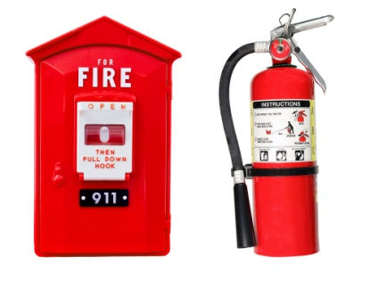
Responding to emergencies
Understand emergency equipment
First aid kits
Emergency documentation
When you have to use the first aid kit
Fire extinguishers
Torch lights
Notes:
Class Activity – Demonstrate emergency equipment
Trainer to demonstrate and explain purpose and use for each of these pieces of emergency equipment.

Slide 128

Responding to emergencies
Responding to emergencies
Implementing emergency and contingency plans
Notifying the authorities
Seeking assistance from emergency services
Placing the safety of people above the protection of assets
Minimising harm, damage and disruption
Notes:
Class Activity – Discuss strategies when responding to emergencies
Trainer to discuss strategies for responding to emergencies.
Trainer to show rules, SOPs etc where applicable

Slide 129

Handling unexpected events
Tour guides may need to adjust a tour to suited unexpected events.
Unexpected events can be classified as:
Negative events – such as accidents and emergencies
Positive events
Notes:
Class Activity – Discuss unexpected events
What are examples of negative events?
How can these be overcome of minimised?
What are examples of positive events?
How can these be maximised to the benefit of tour members?

Slide 130

Dealing with delays
Handling delays
Liaise closely with those responsible for the delay to assess the situation
Advise the clients immediately, accurately inform your group of the reasons for the delay
Explain to the group the action being taken to manage the situation
In many cases you will have to do some quick thinking and devise an alternative plan
Advise suppliers and others affected by the delay, according to company policy
Notes:
Class Activity – Handling delays
What are examples of common delays?
What causes them?
How can you be overcome?

Slide 131

Resolving conflict
While most people who go on tours are generally there to have a good time there are times when conflict issues arise.
Regardless of the type or purpose of conflict the situation must be defused and resolved as quickly as possible:
To the satisfaction of both parties, if possible
With minimal disruption to other tour members
Notes:
Class Activity – Resolving conflict
What are examples of conflict?
How do you resolve conflict?

Slide 132

Resolving conflict
Types of person-to-person conflict
Conflict between tour group members
Conflict between tour group members and non-tour group members
Conflict between tour group members and host enterprise tour guides and other staff members
Conflict involving authorities
Conflict involving local communities
Notes:
Class Activity – Resolving conflict
What are examples of each type of conflict?
How do you resolve these conflict?

Slide 133
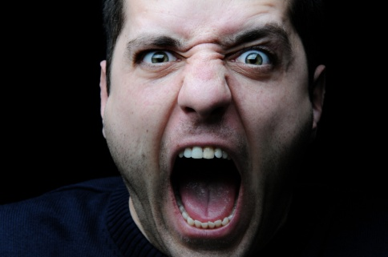
Resolving conflict
Types of person-to-person conflict
Dominant, domineering or disruptive group members
Sub-groups or cliques within the wider tour group
Perceptions of favouritism by tour leader to certain tour group members
Notes:
Class Activity – Resolving conflict
Reflect on personal experiences.

Slide 134

Resolving conflict
Handling person-to-person conflict
How should you handle conflict?
How should you handle drug or alcohol affected clients?
Notes:
Class Activity – Resolving conflict
Discuss the questions in the slide.

Slide 135
Resolving dissatisfaction
Dissatisfaction
Regardless of how professionally you behave, you may encounter customers who are dissatisfied
Customer satisfaction is often dependent on their experience matching their expectation
expectation
experience
satisfaction
Notes:
Class Activity – Resolving dissatisfaction
Why is it important to resolve dissatisfaction?
How can you do this?
What are common causes of dissatisfaction?

Slide 136

Resolving dissatisfaction
Overcoming dissatisfaction
Why is this important?
How can you identify dissatisfaction?
How can you resolve group member dissatisfaction?
Notes:
Class Activity – Resolving dissatisfaction
Discuss the points in this slide.

Slide 137

Optimising enjoyment
Maximising customer enjoyment
It is important that even when adverse or negative factors impact on a tour, the tour guides themselves strive to optimise the enjoyment of the tour and the overall customer satisfaction
Notes:
Class Activity – Resolving dissatisfaction in ‘adverse’ conditions?
What are examples of ‘adverse’ conditions?
How would you overcome these adverse’ conditions to the benefit of customers?

Slide 138

Optimising enjoyment
Maximising customer enjoyment during adverse conditions
What are examples of adverse conditions?
What can you do to maiximise customer enjoyment during adverse conditions?
Notes:
Class Activity – Resolving dissatisfaction in ‘adverse’ conditions?
Discuss questions in the slide.

Slide 139

Optimising enjoyment
Maximising customer enjoyment during adverse conditions
Active listening skills
Identifying what customers expect in adverse conditions
Developing possible tour alternatives
Reach mutual consensus
Notes:
Class Activity – Resolving dissatisfaction in ‘adverse’ conditions?
What other strategies could you utilise?

Slide 140

Finish:
Thank you!
Notes:
This is the conclusion of the subject.
Thank the audience and deliver assessments as required.

